Slide 1

Sector-wise Analysis and Forecasting of NIFTY50
Sai Baba Bheemishetty
Rohan Ashrith Bharadwaj Pendyala
Rohan Vitrouthu
Bharath Simha Reddy Karnati

Slide 2
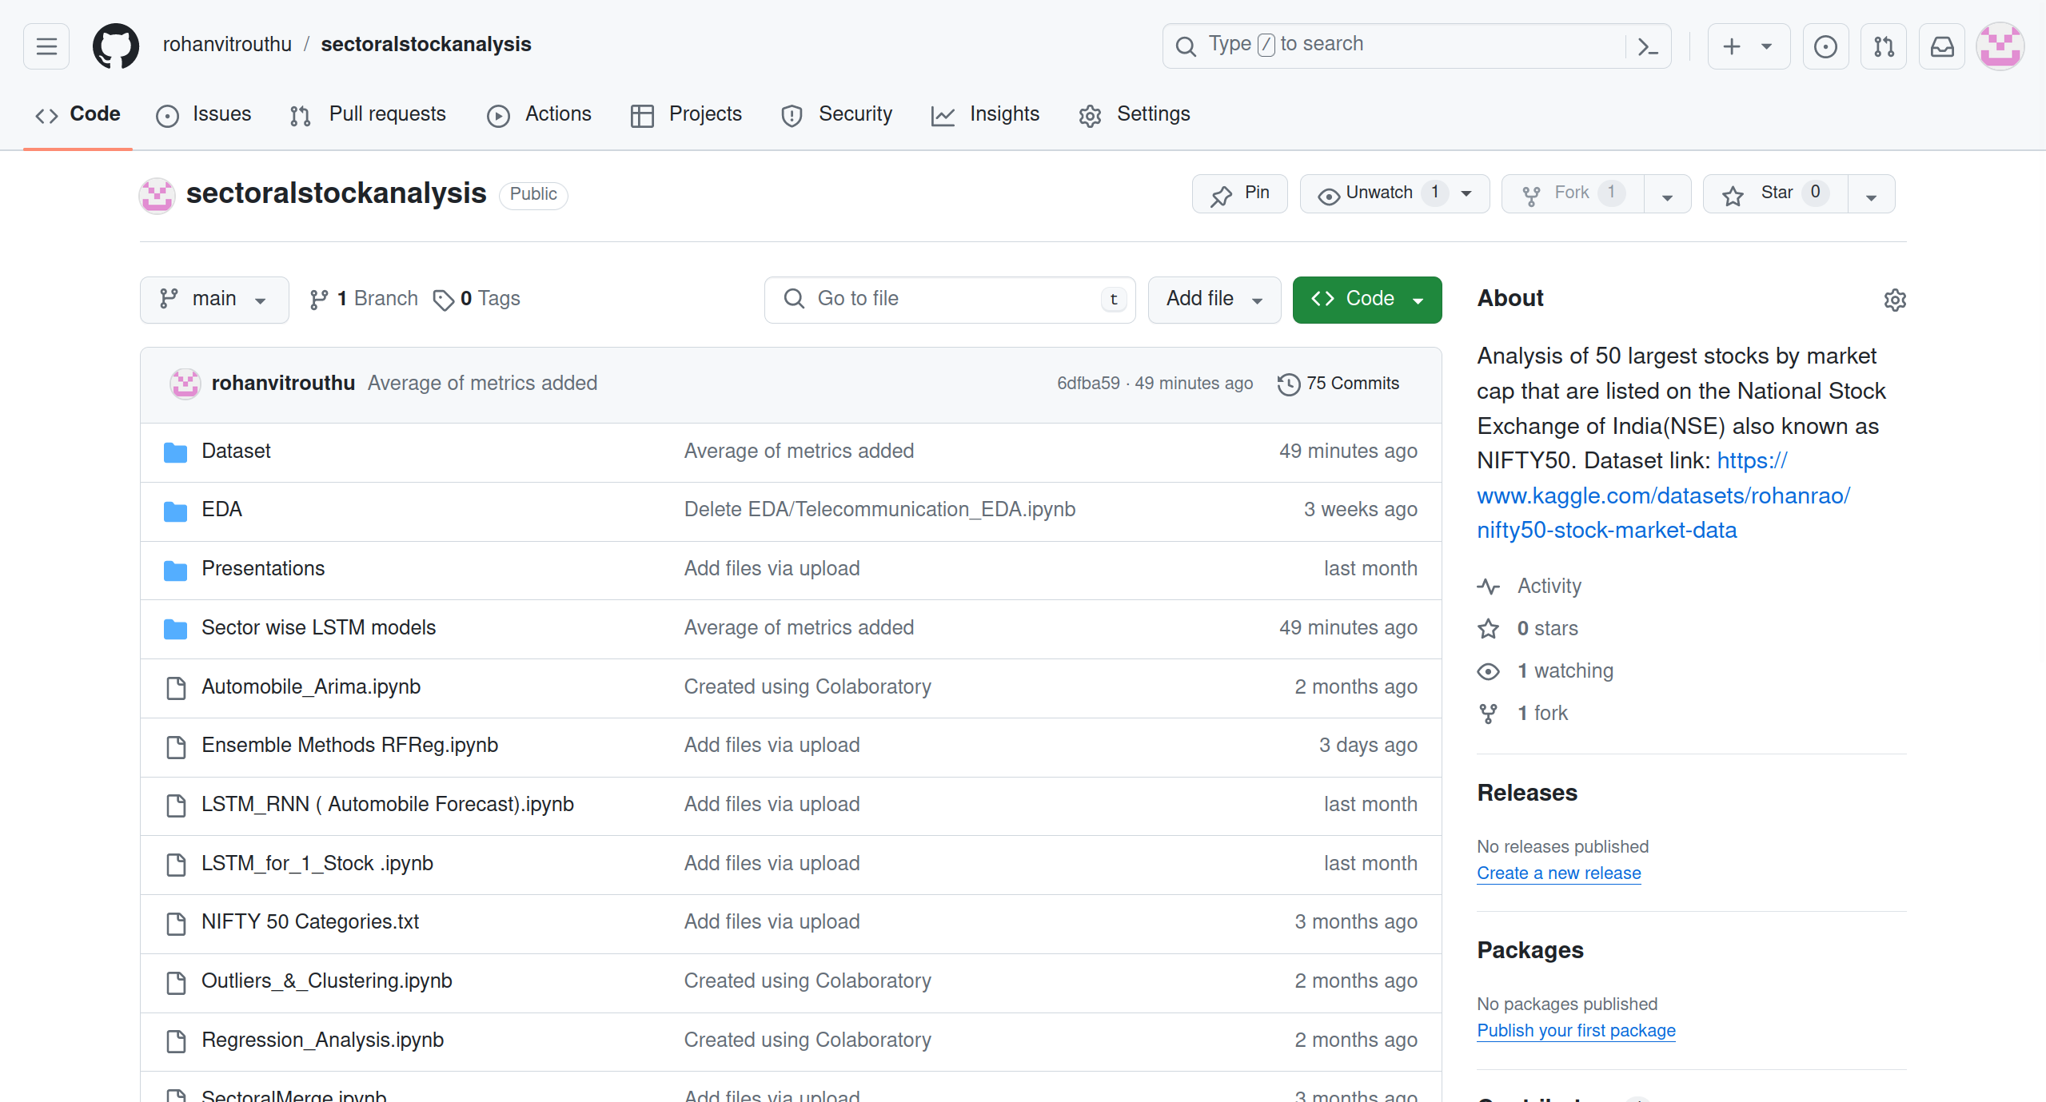
•Kaggle ID: https://www.kaggle.com/datasets/rohanrao/nifty50-stock-market-data
•GitHub Repo: https://github.com/rohanvitrouthu/sectoralstockanalysis
DATA SET AND GITHUB REPOSITORY

Slide 3
Introduction
This project involves analyzing and modeling the Nifty50 stock market dataset from Kaggle.
The Nifty50 is a stock market index that tracks the prices of the top 50 companies listed on the National Stock Exchange (NSE) in India.
It is a key benchmark for the Indian equity market. The goal of this project is to study the price movements and relationships between the 50 stocks that make up the Nifty50 index.
It covers various sectors of the Indian economy, including finance, technology, healthcare, and energy.
Significance: As a barometer of the Indian equity market, the NIFTY50 index plays a crucial role in tracking market sentiment and investor confidence. Understanding the dynamics of its constituent sectors is essential for making informed investment decisions.
https://www.kaggle.com/datasets/rohanrao/nifty50-stock-market-data

Slide 4
About The Data set
The Kaggle dataset contains historical daily price data for the 50 stocks in the Nifty50 index from 1st January, 2000 to 30th April, 2021.
The Size of our Data set is 257 mb and the rows and columns are 235193 X 15
The following are the various attributes present in our dataset:
Date - Trade Date
Symbol - Name of stock
Series - Type of security
Prev Close - Previous data closing price
Open - Opening price for the day
High - Highest price for the day
Low - Lowest price for the day
Last - Last trade price
Closes - Closing price
VWAP - Volume-weighted average price (a ratio of the cumulative share price to the cumulative volume traded over a given time period)
Volume - volume trades for the day
Turnover - The turnover ratio is ratio of sellers to buyers of a stock
Trades - Number of Trades
Deliverable Volume - Amount of deliverable volume
%Deliverable - Percentage of shares that were delivered.

Slide 5
Literature Review
Traditional methods like ARIMA and GARCH struggle to capture complex patterns in stock market prediction .
Machine learning algorithms, particularly Artificial Neural Networks (ANNs) such as Long Short-Term Memory (LSTM) networks and Convolutional Neural Networks (CNNs), have shown promising results by learning from historical data and extracting meaningful features .
Hybrid models combining LSTMs, CNNs, and other techniques have been explored to leverage their strengths and incorporate diverse information sources like fundamental analysis, technical indicators, and sentiment analysis . Despite advancements, challenges remain, including high volatility, noise, feature selection, hyperparameter tuning, and model interpretability.

Slide 6
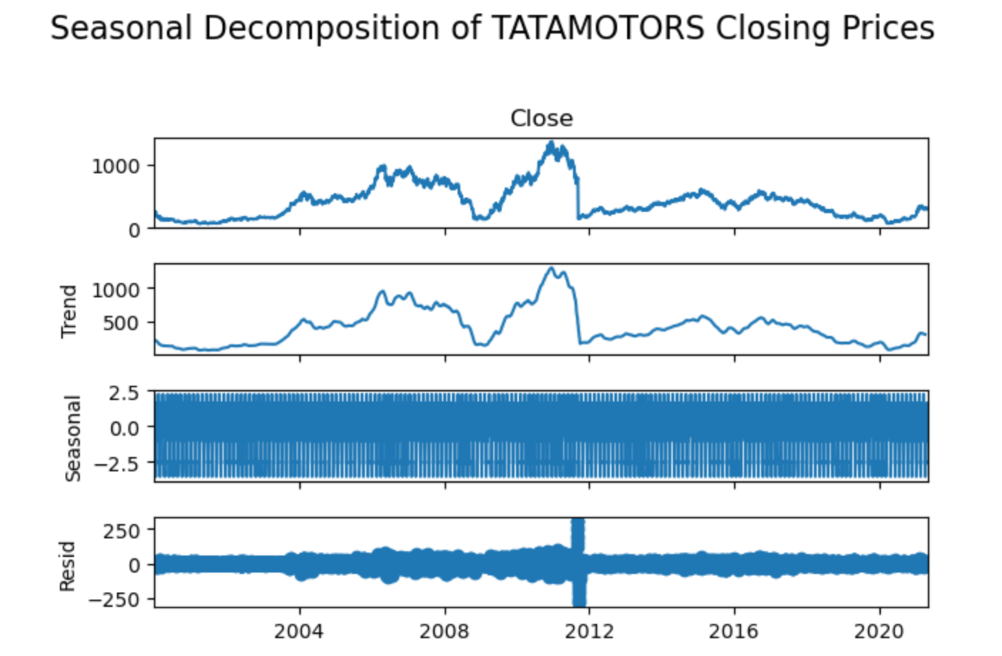
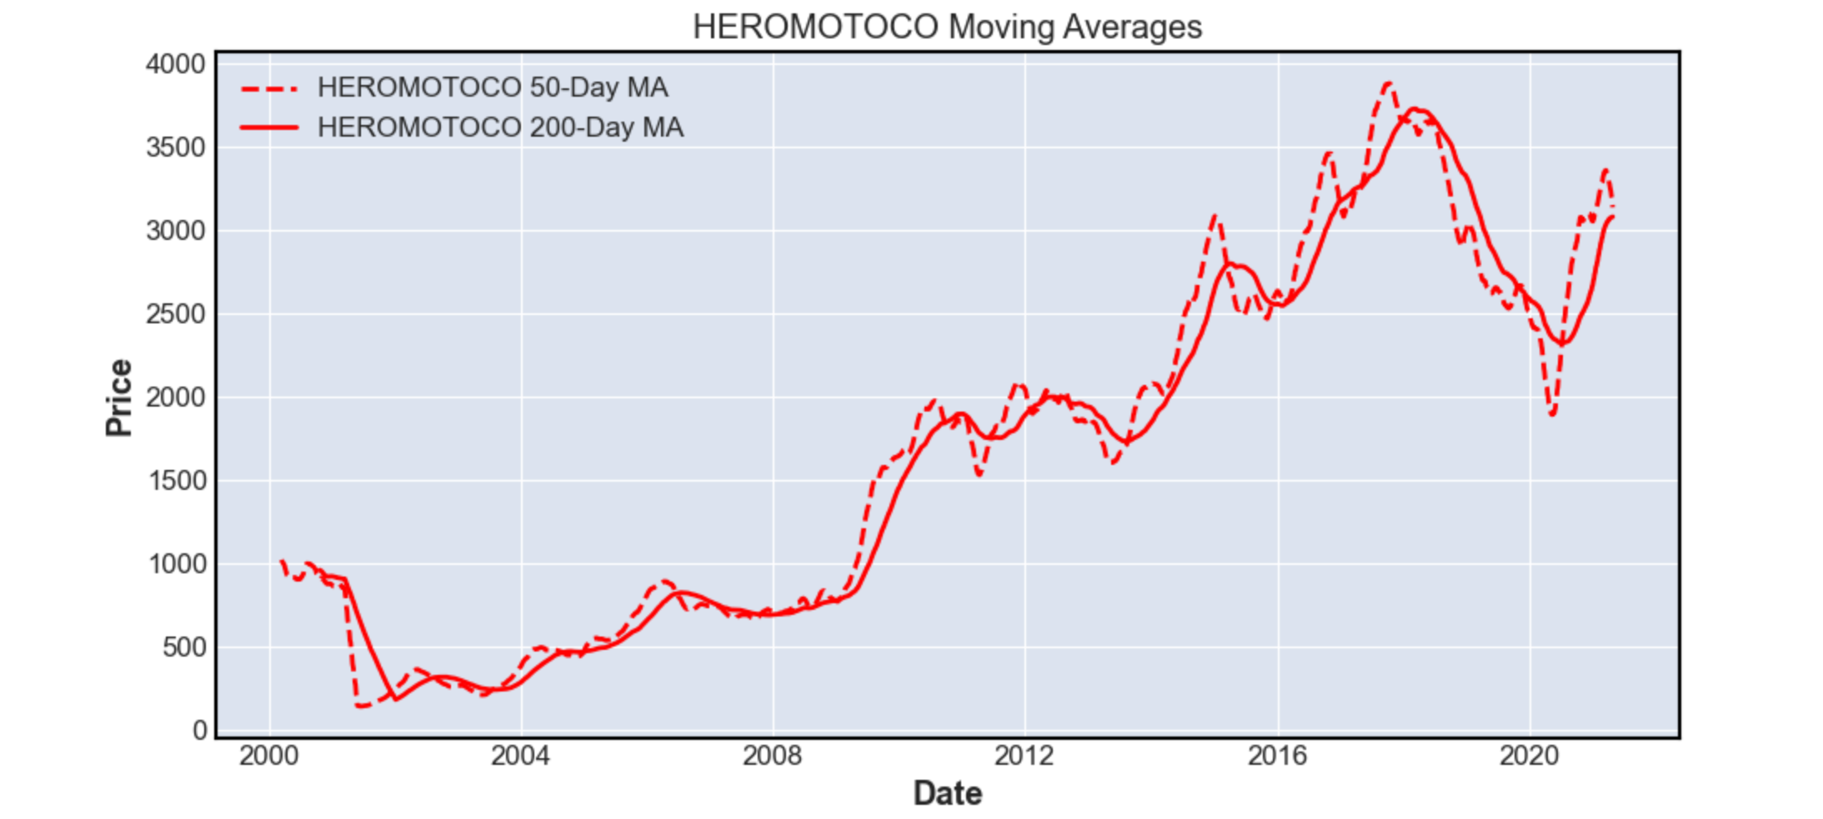
Automobile sector exploratory data analysis
Seasonal decomposition helps unveil the underlying patterns in the data.​
Stock market data is historical data and there are plenty of repeating patterns over time.​
It also helps in identifying anomalies and outliers.​
Due to the large amount of data, the plots for stock market data can be difficult to understand.​
Moving averages simplify this by smoothing the plot to a flowing line for identifying both short-term and long-term trends.

Slide 7
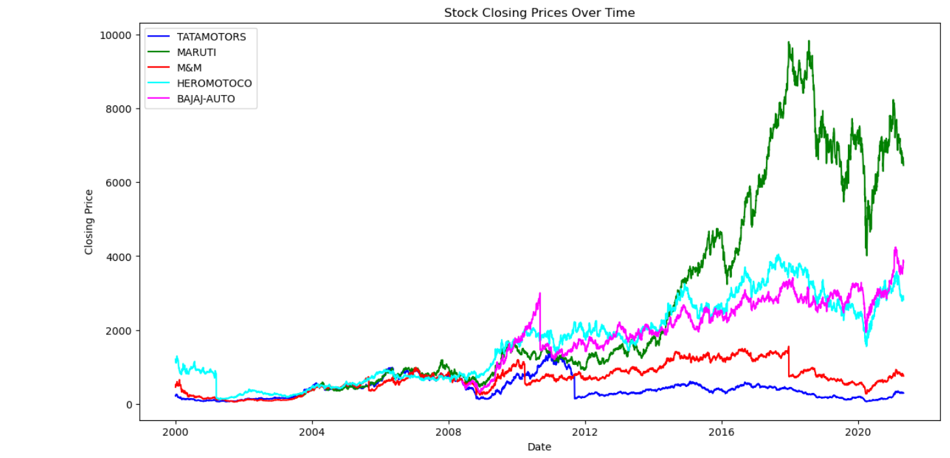
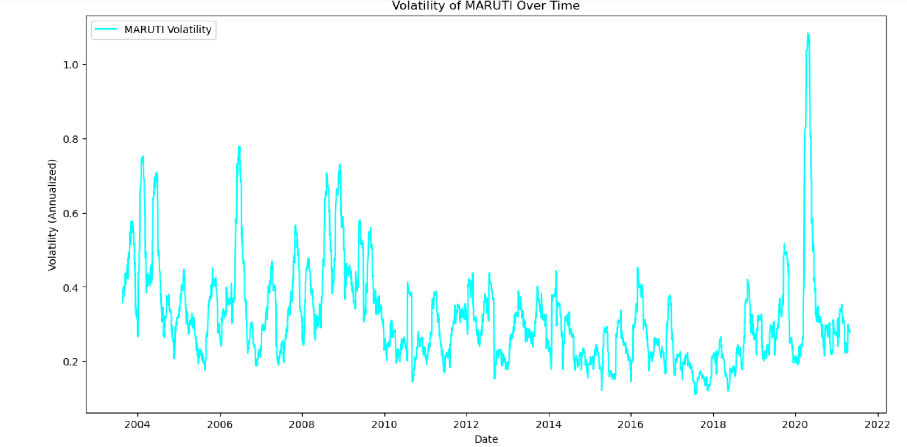
Automobile sector exploratory data analysis
To better understand volatility of stocks in a better manner, we plotted the volatility of each stock separately vs time.​
Volatility is measured as the standard deviation of the stock's daily returns.​
We have also plotted the closing prices of all stocks over time to study their generic trend.​
This plot also helps us understand the volatility of stocks over time due to varying market conditions.

Slide 8
Time Series analysis and forecasting
Trend Identification: Utilizing LSTM to analyze historical data and identify underlying trends within the NIFTY 50 index.
Forecasting Accuracy: Implementing RNN models to forecast future volatility in closing prices, with a focus on improving prediction accuracy and understanding market behavior.
Machine Learning Integration: Applying LSTM deep learning algorithm to enhance the predictive capability for the NIFTY 50 index's future stock returns.
Volatility Analysis: Modeling the volatility of the NIFTY 50 using advanced techniques to capture the dynamic nature of the market and inform risk management strategies.
Comprehensive Approach: Combining various statistical and machine learning methods to provide a robust analysis of the NIFTY 50 time series data, aiding in investment decision-making.

Slide 9
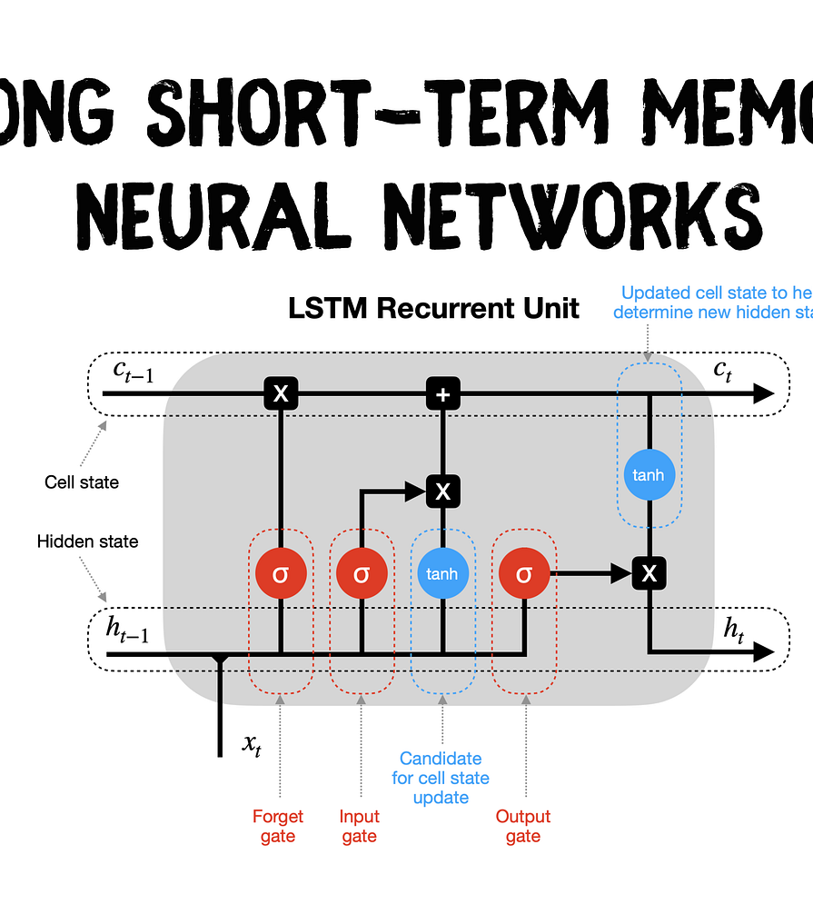
Forecasting Using lstm
Definition and Background::LSTM is a type of recurrent neural network (RNN) capable of learning order dependence in sequence prediction problems. Unlike standard feedforward neural networks, LSTM has feedback connections that make it capable of processing entire sequences of data.
Importance in Time Series Analysis: LSTMs are well-suited for time series prediction tasks because they can store past information. This is crucial in stock price forecasting, where past price information is valuable for predicting future stock prices.

Slide 10
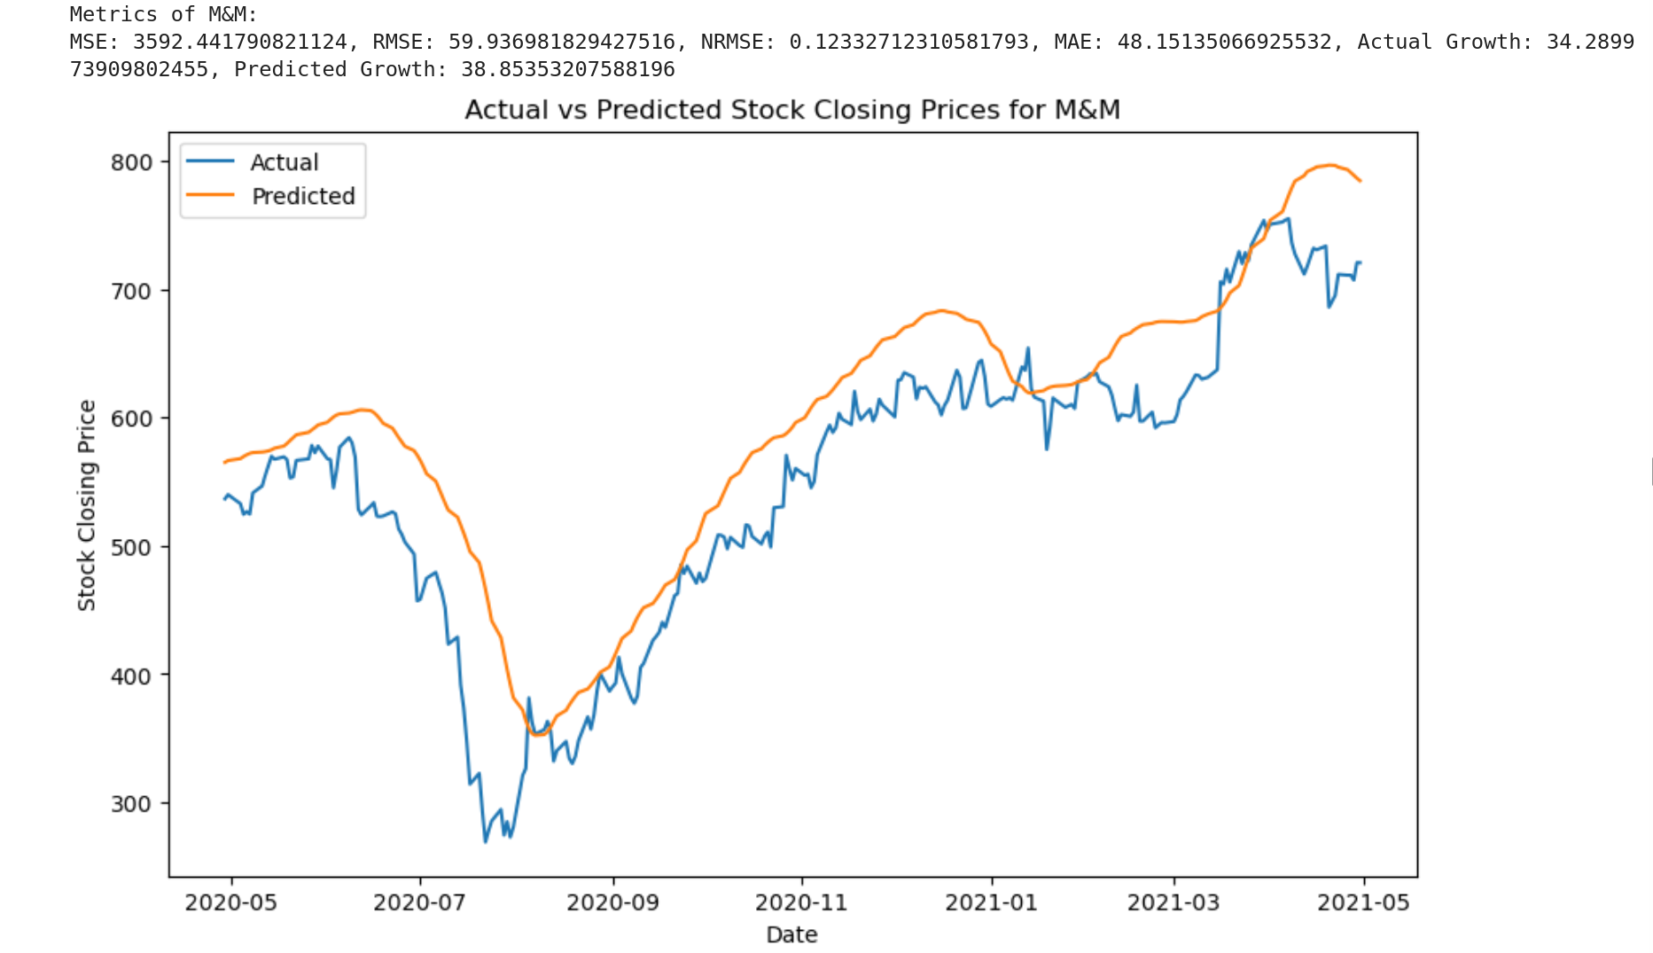
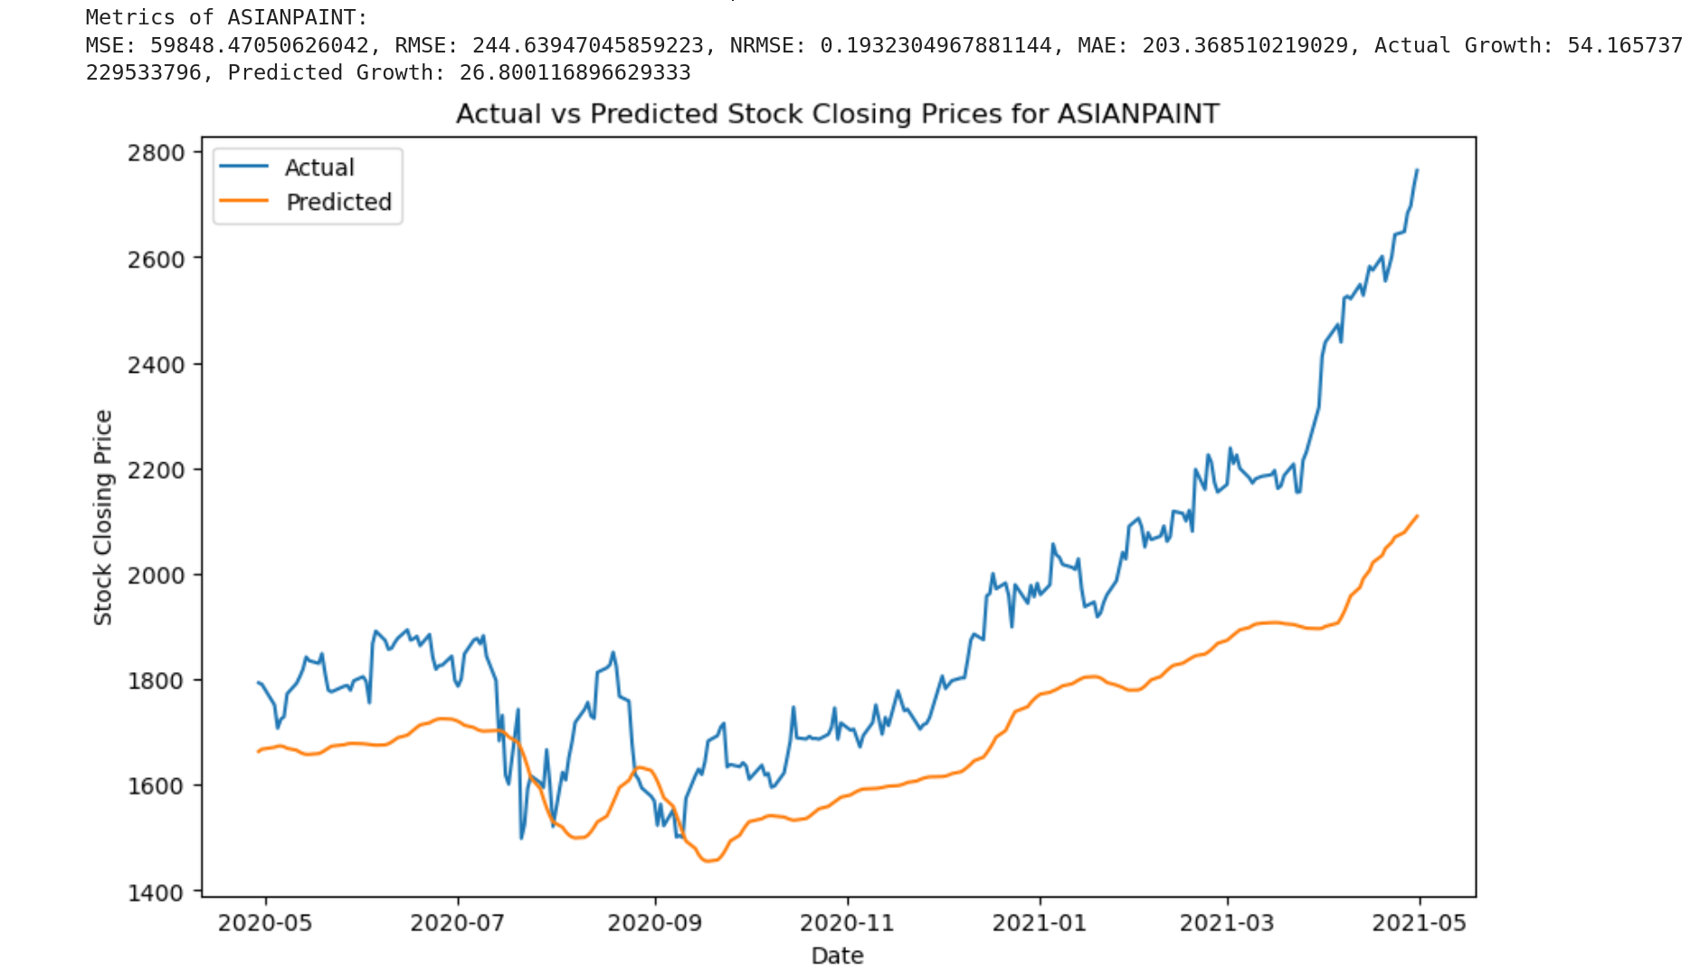
Best Performing Stock in each sector
Automobile Sector: Mahindra & Mahindra
Consumer Durables Sector: Asian Paints

Slide 11
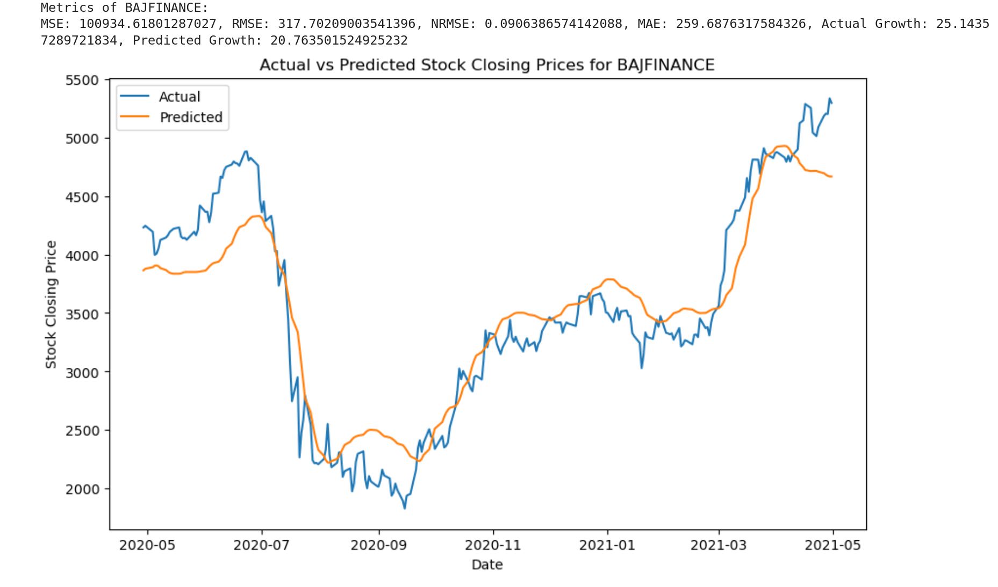
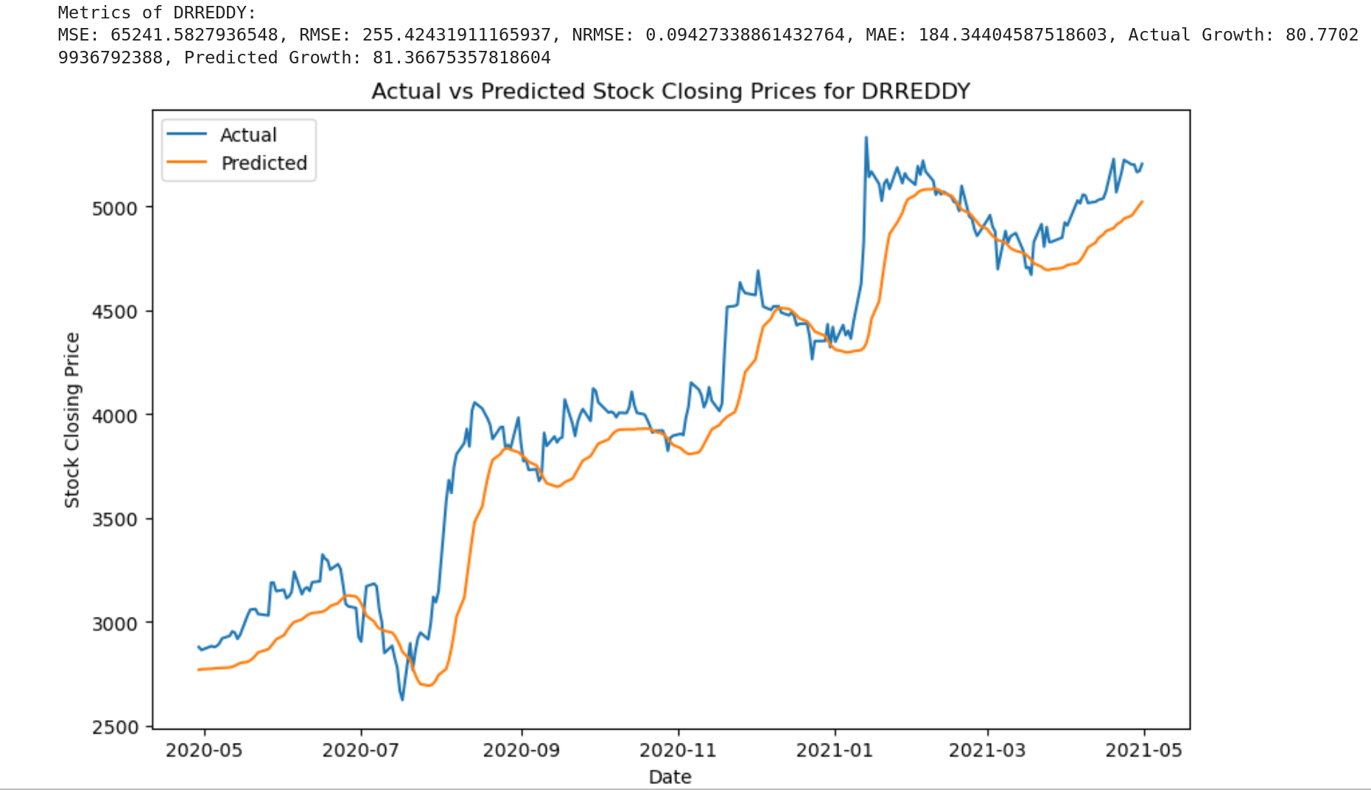
Best Performing Stocks in each sector
Financial Services Sector: Bajaj Finance
Healthcare Sector: Dr. Reddy's

Slide 12
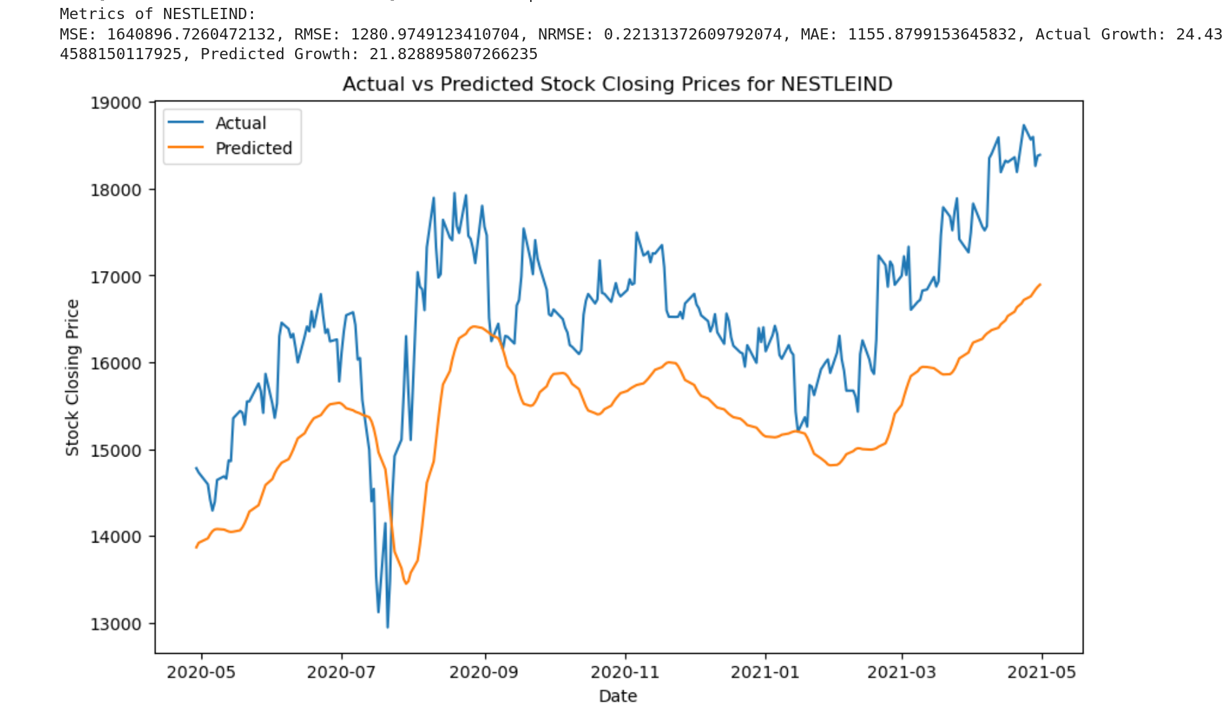
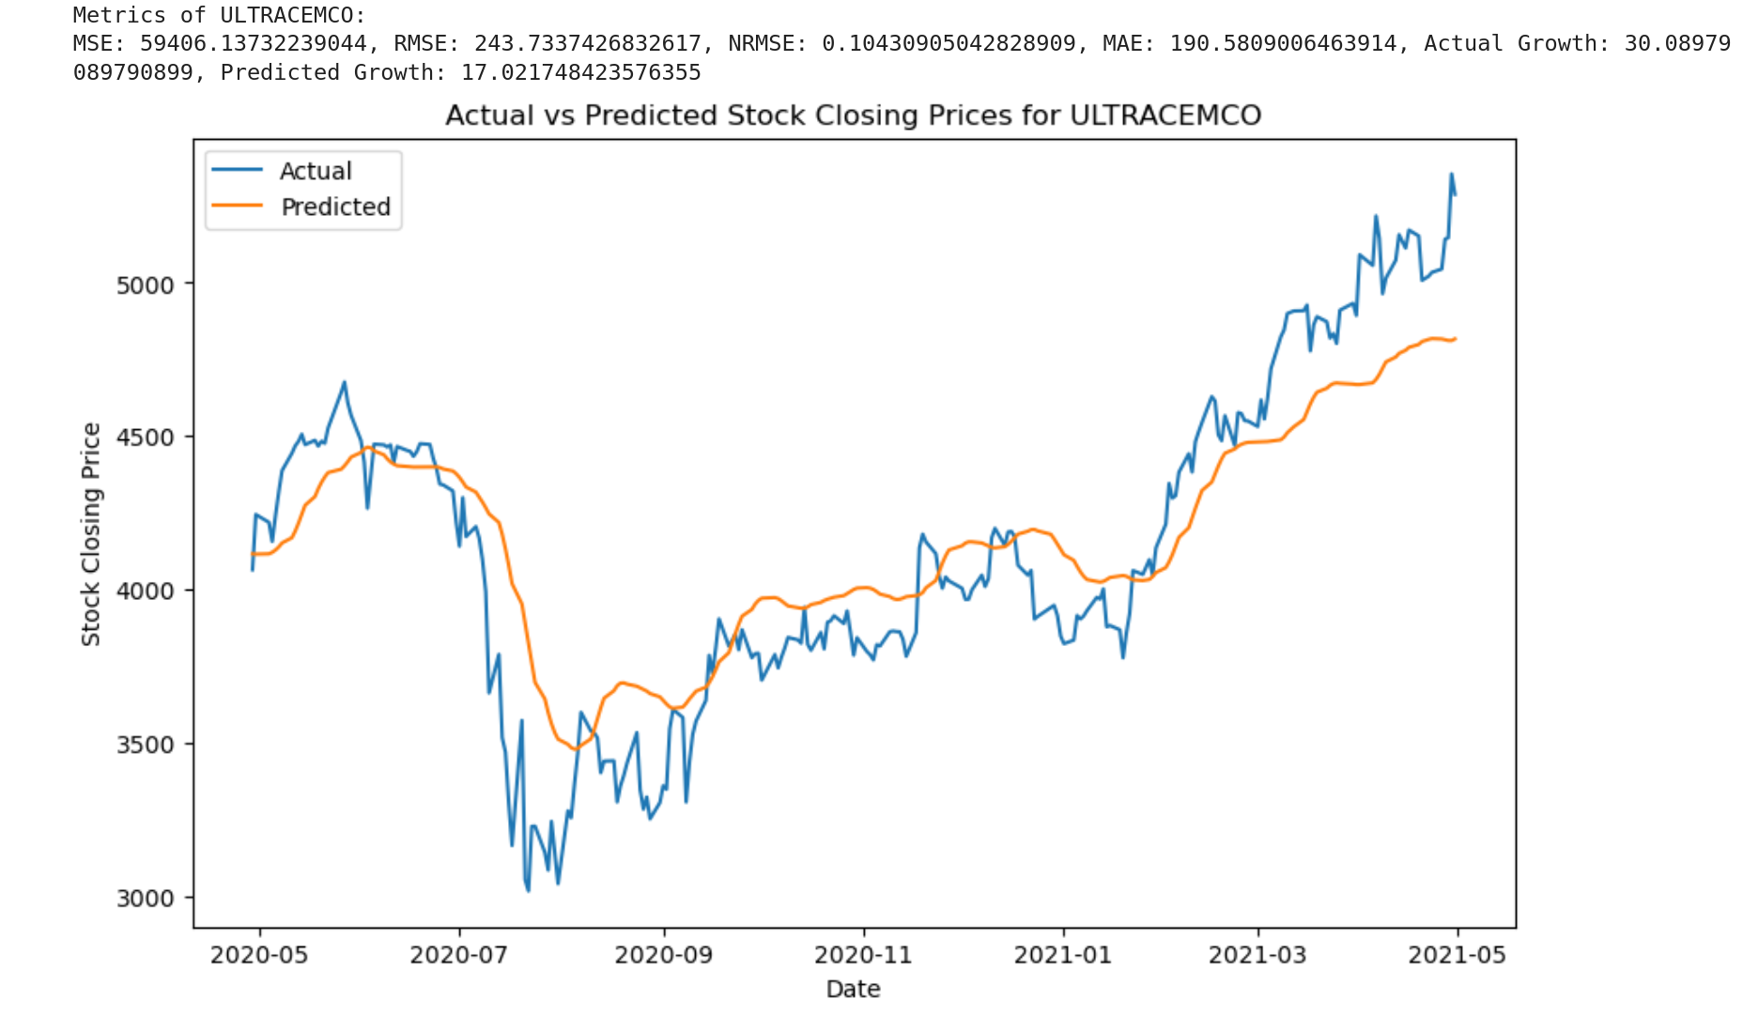
Best Performing Stocks in each sector
Fast Moving Consumer Goods Sector: Nestle India
Construction Materials Sector: Ultra Cement Co.

Slide 13
Rmse & nrmse values of the stocks
Stock Name | MSE | RMSE | NRMSE
Mahindra & Mahindra | 3592.441790821124 | 59.936981829427516 | 0.12332712310581793
Asian Paints | 59848.47050626042 | 244.63947045859223 | 0.1932304967881144
Bajaj Finance | 100934.61801287027 | 317.70209003541396 | 0.0906386574142088
Dr. Reddy's | 65241.5827936548 | 255.42431911165937 | 0.09427338861432764
Nestle India | 1640896.7260472132 | 1280.9749123410704 | 0.22131372609792074
Ultra Cement Co. | 59406.13732239044 | 243.7337426832617 | 0.10430905042828909

Slide 14
Forecasting using rnn( Recurrent neural networks)
LSTM RNN Model for Automobile Stock Forecasting: The use of a Long Short-Term Memory (LSTM) Recurrent Neural Network (RNN) to forecast automobile stock prices.
Model Training: The LSTM model is trained over fifty epochs, with the loss decreasing from 0.0146 in the first epoch to 0.0017 in the final epoch, indicating improved model performance over time.
Validation and Evaluation: The model's performance is evaluated using Mean Squared Error (MSE) as the loss function. The final MSE value is 0.00022589, indicating a high level of accuracy in the model's predictions.
The LSTM RNN model proves effective in forecasting automobile stock prices, providing a robust and accurate approach to time series analysis.

Slide 15
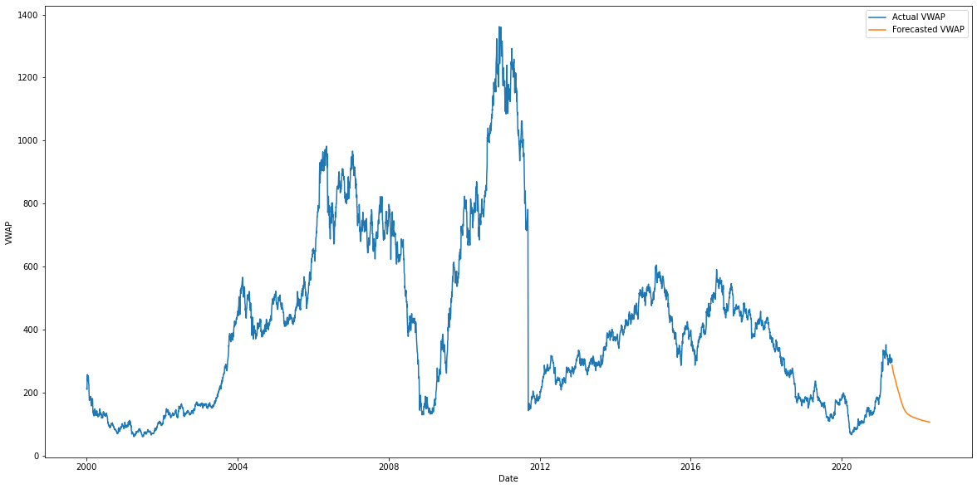
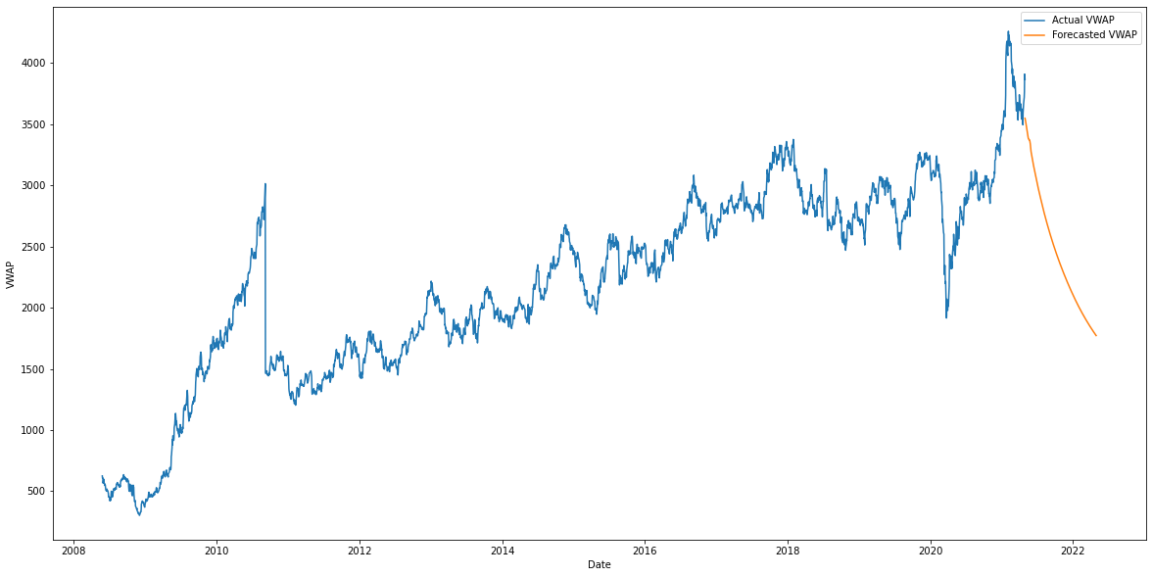
Forecasting using rnn model for ‘tata motors’ and ‘bajaj auto’ stocks
Forecasting using RNN for Tata Motor stocks
Forecasting using RNN for Bajaj Auto stocks

Slide 16
Growth Percentages
Stock Name | Actual Growth | Predicted Growth
Mahindra & Mahindra | 34.289973909802455 | 38.85353207588196
Asian Paints | 54.165737229533796 | 26.800116896629333
Bajaj Finance | 25.14357289721834 | 20.763501524925232
Dr. Reddy's | 80.77029936792388 | 81.36675357818604
Nestle India | 24.434588150117925 | 21.828895807266235
Ultra Cement Co. | 30.08979089790899 | 17.021748423576355

Slide 17

Future work
Hybrid Models: Combine LSTM with other models like Convolutional Neural Networks (CNNs) to capture both temporal and spatial features in the data.
Attention Mechanisms: Implement attention mechanisms in your LSTM model to allow the model to focus on the most relevant parts of the input sequence.
Back testing: Implement a back testing framework to simulate trading on historical data and evaluate the performance of your strategy over time.

Slide 18
References
Moghar, A., & Hamiche, M. (2020). Stock Market Prediction Using LSTM Recurrent Neural Network. Procedia Computer Science, 170, 1168–1173. https://doi.org/10.1016/j.procs.2020.03.049
‌Wikipedia Contributors. (2019, August 3). Stock market prediction. Wikipedia; Wikimedia Foundation. https://en.wikipedia.org/wiki/Stock_market_prediction
‌(2021). Capital.com. https://capital.com/stock-market-prediction-definition
‌Sector Analysis: Definition, Framework, Factors, How to do it. (n.d.). Www.strike.money. https://www.strike.money/fundamental-analysis/sector-analysis
‌Shaban, W. M., Ashraf, E., & Ahmed Elsaid Slama. (2023). SMP-DL: a novel stock market prediction approach based on deep learning for effective trend forecasting. Neural Computing and Applications. https://doi.org/10.1007/s00521-023-09179-4
‌Shaban, W. M., Ashraf, E., & Ahmed Elsaid Slama. (2023). SMP-DL: a novel stock market prediction approach based on deep learning for effective trend forecasting. Neural Computing and Applications. https://doi.org/10.1007/s00521-023-09179-4
‌Mintarya, L. N., Halim, J. N. M., Angie, C., Achmad, S., & Kurniawan, A. (2023). Machine learning approaches in stock market prediction: A systematic literature review. Procedia Computer Science, 216, 96–102. https://doi.org/10.1016/j.procs.2022.12.115

Slide 19

Thank you

